Slide 1

Datta Meghe College of Engineering , Airoli Placement Management System
Team Members :
1. JIDNYASA SUNIL BHOIR 2019FHIT108
2. SHITAL HANUMAT KACHARE 2019FHIT069
3. DIKSHA SURYABHAN SAHU 2019FHIT030
GUIDED BY : Prof. G.M. Arwindekar

Slide 2

Contents :
INTRODUCTION
PROBLEM DEFINITION
SCOPE OF PROJECT
OBJECTIVES OF PROJECT
SOFTWARE REQUIREMENT
IMPLEMENTATION
CONCLUSION
FUTURE SCOPE
REFERENCES

Slide 3
INTRODUCTION :
The system is a web application that can be accessed by students with proper login provided.
The purpose of the project “PLACEMENT MANAGEMENT SYSTEM”, the manual work makes the process slow and other problems such as inconsiste
We all use the internet to do multiple things.
Used to assist students to get information related to campus placement.
Web application that can be accessed by students.
Fast in fast access procedures in placement related activities.
To view the list of the companies , their job description and also apply for the job.
ncy and ambiguity.
In order to avoid this web based placement managed system is proposed, where the student information in the college with regard to placement is managed efficiently.
It intends to help fast in fast access procedures in placement related activities and ensures to maintain the details of the student. Students logging should be able to upload their personal and educational information.
Our project provides the facility of maintaining the details of the students and gets the list and details of the companies who would like to recruit the students.

Slide 4
PROBLEM DEFINITION ::
This application is designed to develop a Placement Management System to assist students to apply in campus recruitment.
We have build a project that will have several features such as:
Login Form
Student Registration
Company Registration
Home Page
Apply Page

Slide 5
SCOPE OF PROJECT : :
This project has a large scope as it has the following features which help in making it easy to use, understand and modify it.
Automation of Placement Procedure.
To save the environment by using paper free work .
To increase the accuracy and efficiency of placement procedure.
Management of Student Data.

Slide 6
OBJECTIVES OF PROJECT : :
The main objective of Placement Management System is to develop software which manages placement activities in college makes a interactive GUI where Training and placement officers can manage details of all students on his console.
The proposed system intends user-friendly operations which may resolve ambiguity.
The student information in the college with regard to placement is managed efficiently.

Slide 7
SOFTWARE REQUIREMENT :
Front End - HTML
Back End - Python Flask
Operating System - Windows 10
HARDWARE USED :
SSD – 256GB
RAM - 8GB

Slide 8
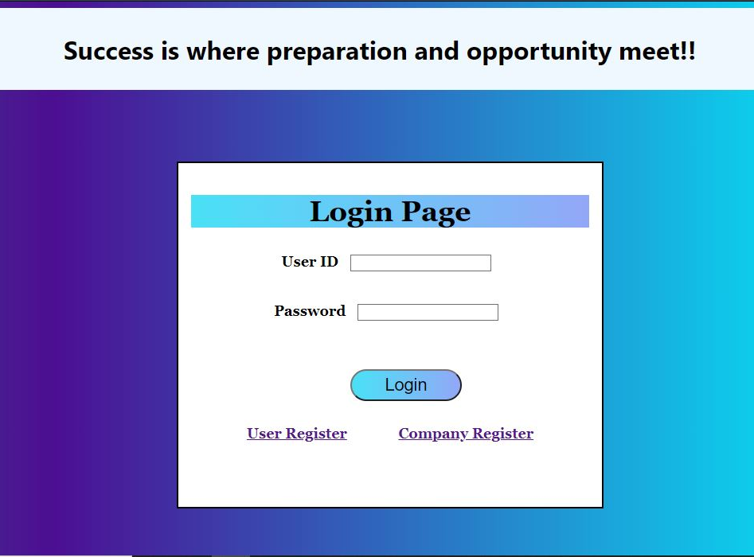
IMPLEMENTATION :
LOGIN FORM :-

Slide 9
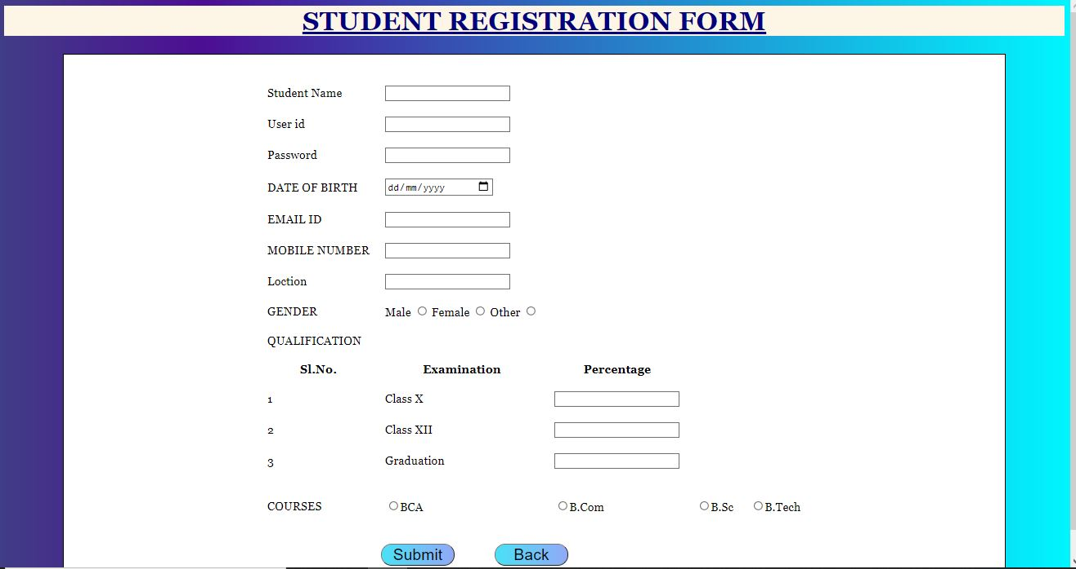
STUDENT REGISTRATION :-

Slide 10
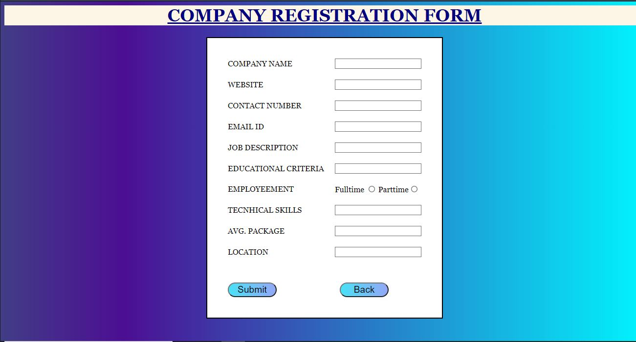
COMPANY REGISTRATION :-

Slide 11
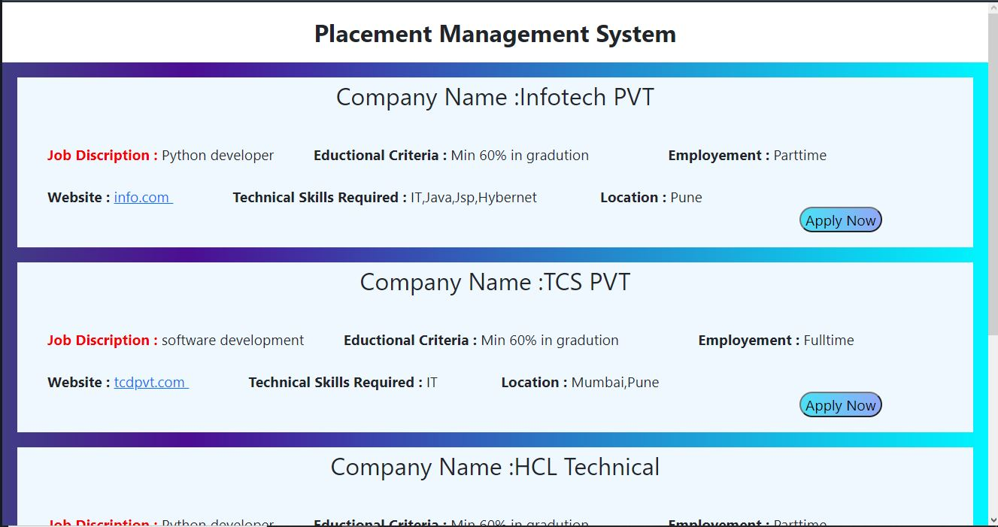
HOME PAGE :-

Slide 12
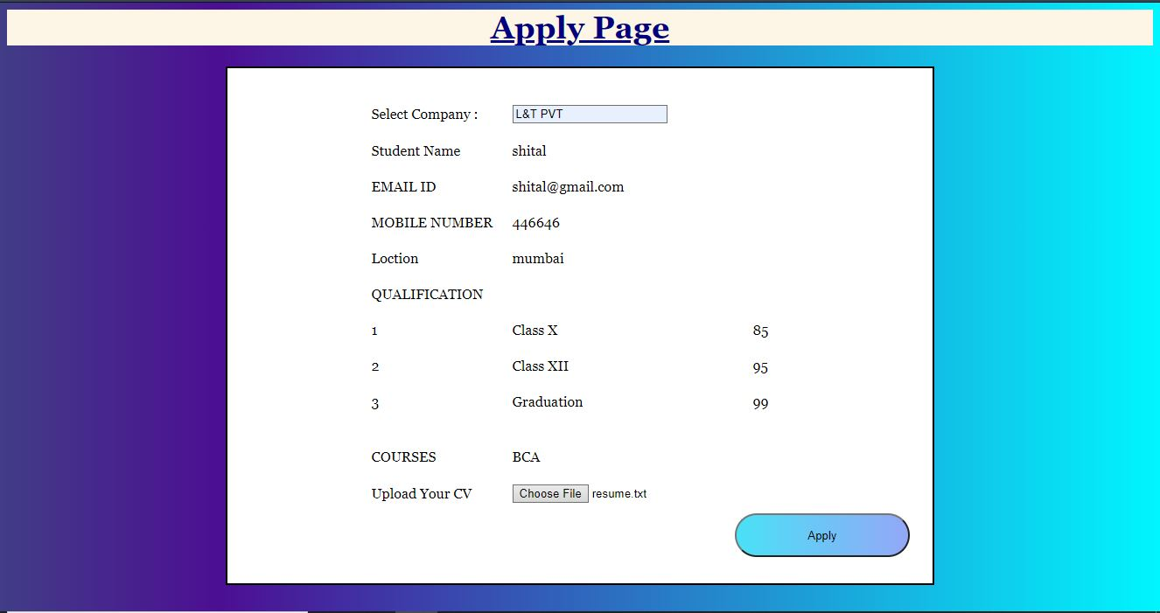
APPLY PAGE :-

Slide 13
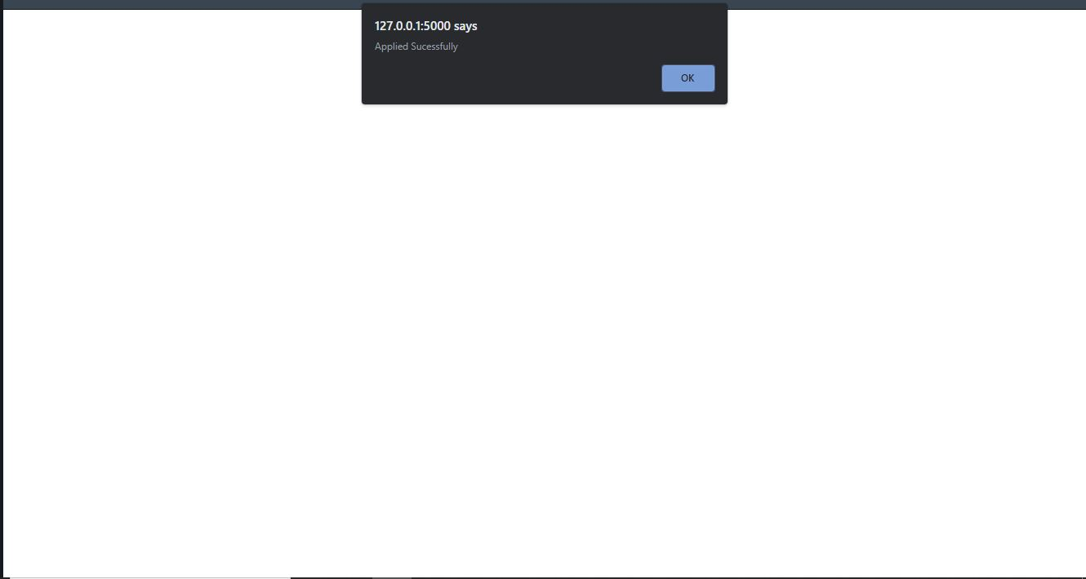
APPLIED SUCCESFULLY :-

Slide 14
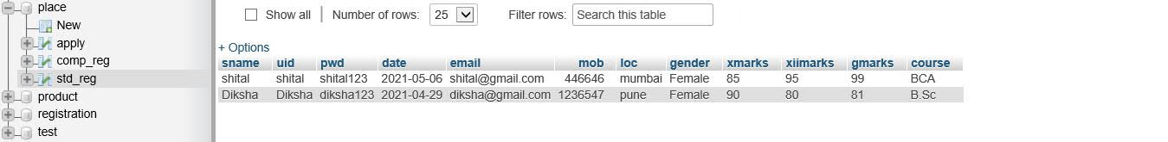
DATABASE :- Student Database :

Slide 15
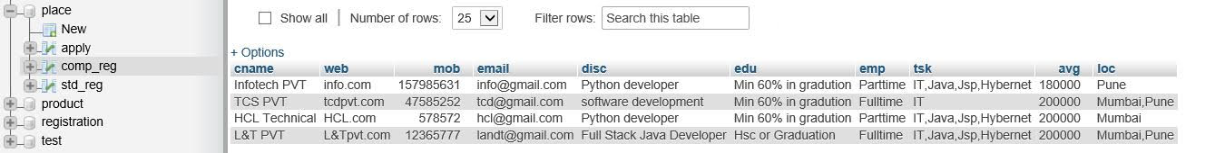
Company Database :

Slide 16
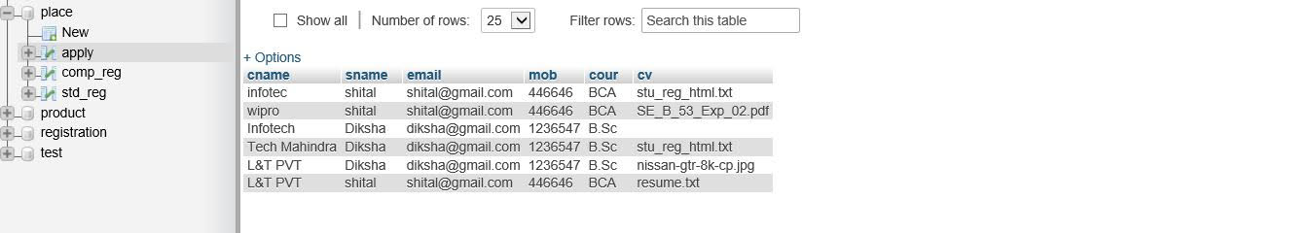
Students Applied :

Slide 17
CONCLUSION :
User Friendly.
Simplifies the management process.
Fast processing.
It minimizes human effort.
Cost-efficient databases.
Navigation through the site is easy.

Slide 18
FUTURE SCOPE :
Direct communication with employer and Direct E-interview system .
Can be used by Placement Officers of the College.
Will aid colleges to practice full IT deployment.

Slide 19
REFERENCES :
http://www.wikipedia.org
http://www.google.co.in
http://www.youtube.com

Slide 20
THANK YOU.

